Slide 1
Sprint 3
Team 9

Slide 2
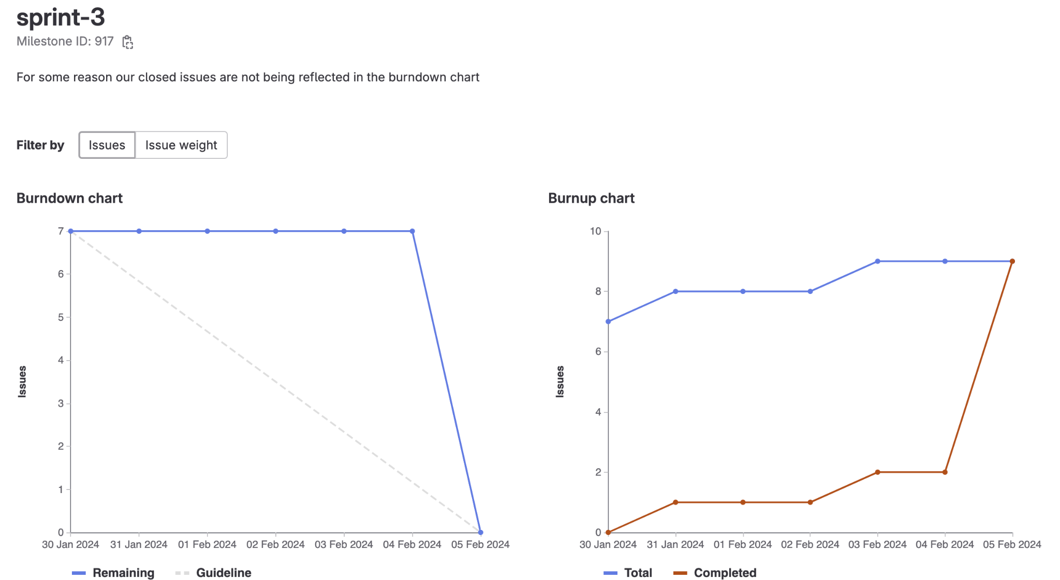
Milestone 3 chart

Slide 3
Things to improve : Things done well
Team meetings and scheduling
Burndown chart for starting the milestone
Members cooperated well
Completion of Game logic and UI
Socket implementation
About me page update
CI/CD updating script for install/uninstall

Slide 4
Muhammad
Phaser game implementation part 1 & 2
About me page and Game bugs
Total weights : 14

Slide 5
Karina
Worked on game implementation
Created install and uninstall scripts for VM
Updated tests for CI/CD
Completed About Me description and added profile photo
Total Weights: 14

Slide 6
Cavaari
Worked on game implementation
Styling Game Page
About Us
Documentation
Updating CI/CD scripts
Total Weights: 12

Slide 7
Egor
Game logic classes
Create room socket implementation
Join room socket implementation
Total weights: 12

Slide 8
Tehreem
Starting game logic
Join room socket implementation
Create room socket implementation
Total weights: 12

Slide 9
Eric
Implemented about us page with Egor
Added Death card and implemented You Win and You lose screen and logic with Kal
Total Weights: 12

Slide 10
Kalindu
Added end game logic + card texture creation
About me page
Game bugs
CI/CD testing
Total weight: 12

